Slide 1

June 2021 - Mid Year
Chapter News
Mark your calendars September 24, 2021

Slide 2

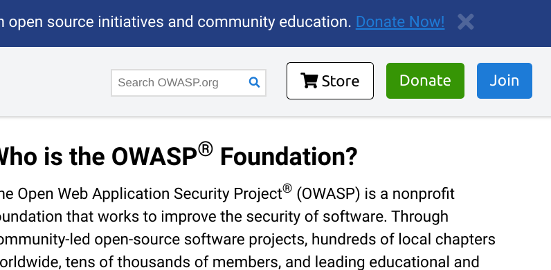
What's New?
OWASP’s 20th Anniversary is right around the corner. Mark your calendars for September 24, 2021. Let’s try to get every OWASP chapter to promote and attend this historic event. Anniversary Banners
OWASP Online Retail Store - This is NOT SWAG and can not be submitted for reimbursement. It is an online retail store open to the public to purchase OWASP Gear. It is on the top of every OWASP page.

Slide 3
What’s New? (continued)
OWASP Membership Portal and Email Cleanup
Important dates to keep in mind for the initial campaign:
July 1: Membership Portal opens
July 26: Membership email cleanup begins - first notices of deactivation
August 2: Second notice of deactivation
August 8: Final notice of deactivation
August 9: Email deactivation if no action was taken
Click on the link for complete details.

Slide 4
Chapter Page Updates
URL Updates required on (some) chapter pages.
Chapter Handbook is Chapter Policy
Speaker Agreement
Code of Conduct
Donations
OPTIONS:
Use the Policy page URL. [https://owasp.org/www-policy/] This page will always have the current version and list of ALL OWASP policies. This page is regularly reviewed and maintained by the Foundation to be financially and legally compliant in some instances.
Or you can reference the specific document. With this choice, you will need to check and maintain the chapter page regularly. For example, the Chapter handbook changed names to chapter policy.
** Any wiki links or redirects for information will need to be changed. The wiki site with the information will be retired at a future date. If you want the information, download it to the GitHub chapter repository. **

Slide 5
Only 6 months left in 2021
The Pandemic was devastating, but we are surviving and successfully moved chapter meetings to Zoom.
Suppose you need a Zoom account to enter a Contact Us ticket with topic shared services.
Company put the chapter name and link OWASP chapter page.
Make sure that your leader.md file has leaders’ names and emails because there is automation in the backend that sends the ID and password to all the leaders in the file.
The new chapter policy only calls for three meetings/activities in 12 months. Ensure that your OWASP chapter page has the date, time, and location/URL before it starts.
If you use the free Meetup Pro account provided by the Foundation with the metadata, this is done automatically when you schedule your Meetup.
If you need additional assistance or resource to get going, please visit the Chapter Committee Resource page or reach out to them chapter-committee@owasp.org

Slide 6
Membership
The OWASP Foundation, just like many others, has been hit hard financially. The in-person Global Appsec events that the Foundation hosts annually did not take place in 2020. Those two events provide approximately 80% of the annual revenue needed for the Foundation to stay solvent.
Let’s actively start promoting individual membership at all chapter meetings. We have a great community, and I am sure they would like to help keep OWASP around for another 20 years.
“Why you should become an OWASP Member?”

